Slide 1

Stage 1 The Big Pentagram Course Designer: Arthur Wang
The Big Pentagram is a 24 round, 120 point, COMSTOCK Long course. There are 11 IPSC targets and 2 steel targets. The best 2 hits per cardboard target will score. Steel must fall to score. The start signal is audible.
The start position is standing with feet touching marks. Handgun loaded and holstered with wrists below belt. PCC stock on belt, safety on.
On the audible start signal, engage all targets from within the shooting area.

Slide 2
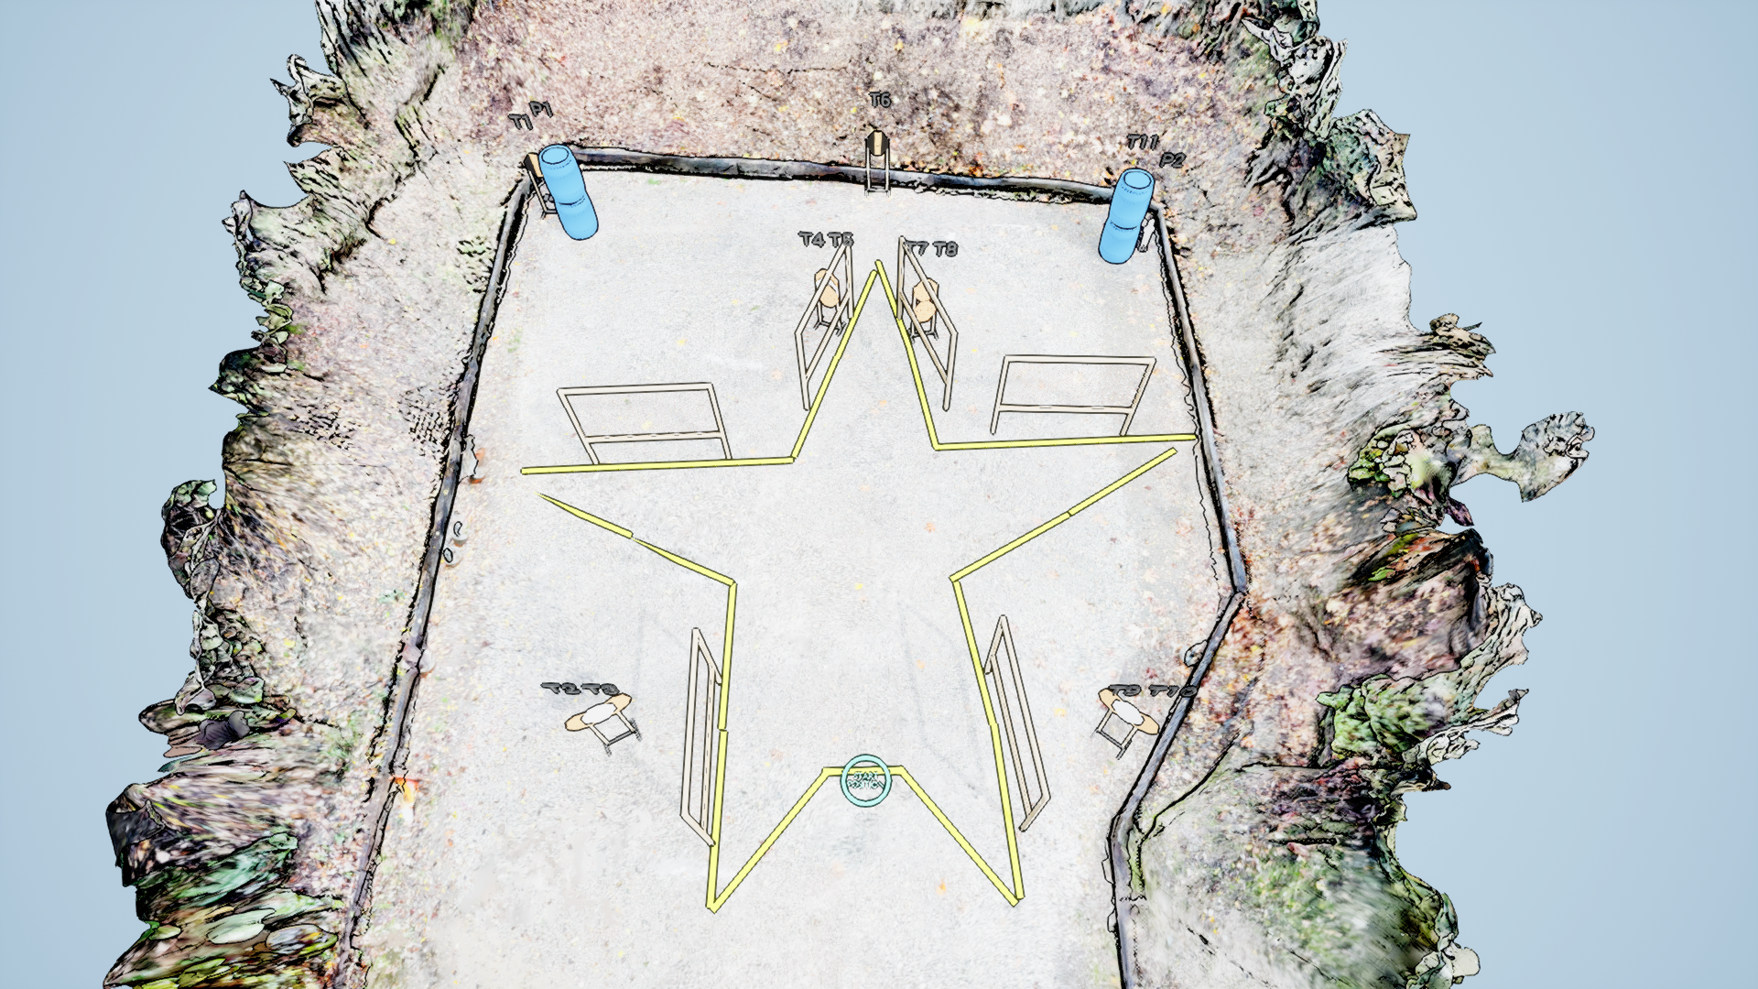
 | Stage 1 The Big Pentagram Course Designer: Arthur Wang

